Slide 1


Early Stages of Analysis

Slide 2
LAB SETTING
Steps for Analyzing Qualitative Data
Three stages (Miles, Huberman and Saldana, 2014) | Six steps (Creswell, 2012)
Data Condensation | Preparing and organizing the data for analysis Exploring the data through coding Using codes to develop description and themes
Data display | Representing the findings through narratives and visuals
Drawing and verifying conclusions | Making an interpretation of the meaning of the findings Using strategies to validate the accuracy of the findings

Slide 3
DATA PREPARATION
Transcribing
Analysis begins with transcription.
Transcribe early!
Use a transcription aid, such as ExpressScribe or an audio player with Global Hot Keys.
Put a time stamp often. It can be helpful, if you need to review the audio while analyzing.
Note down (or highlight) compelling words and phrases. They can be used when presenting your findings.

Slide 4
DATA PREPARATION
Transcribing
The key to transcribing is capturing the meaning of people’s words, so although you should aim for exact transcription, don’t shy away from paraphrasing, dropping unnecessary words, or adding parenthetical expressions to provide context. However, always make it clear which words are yours and which are the participants’ (Goodman, Kuniavsky and Moed, 2012, p.426)
Use [ ] to write down things that the respondent did not say, but important to be noted down, such as
  time intervals e.g. […], [pause];
  gestures or activities of the respondent that can be important while interpreting the data e.g. [laughing], [pointing at the figure]
  parts, where you cannot hear the audio e.g. [inaudible]

Slide 5
DATA CONDENSATION
Coding – What is a code?
Codes are labels that assign symbolic meaning to the descriptive or inferential information compiled during a study.
Codes usually are attached to data “chunks” of varying size and can take the form of a straightforward, descriptive label or a more evocative and complex one (e.g. metaphor)
  (Miles, Huberman and Saldana, 2014)
Notes:
So you have all these transcriptions of data that you gathered. You know that there are commonalities. So how do you identify them? How do you make sense of them?
To make sense of what you gather from the field, first you need to code all of your data to see patterns and commonalities…

Slide 6
DATA CONDENSATION
Coding – How codes are used?
Codes are primarily, but not exclusively, used to retrieve and categorize similar data chunks so the researcher can quickly find, pull out, and cluster the segments relating to a particular research question, hypothesis, construct or theme.
Clustering and the display of condensed chunks then set the stage further analysis and drawing conclusions.
  (Miles, Huberman and Saldana, 2014)

Slide 7
DATA CONDENSATION
Coding – How codes are used?
Codes are prompts or triggers for deeper reflection on the data’s meanings.
Coding is thus a data condensation task that enables you to retrieve the most meaningful material, to assemble chunks of data together, and further condense the bulk into readily analyzable units.
  (Miles, Huberman and Saldana, 2014)

Slide 8
DATA CONDENSATION
Coding – What to look for while coding
Values – Consequences – Attributes
Goals
Behaviors
Tasks
Concerns
Strategies
Expectations

Slide 9
DATA CONDENSATION
Coding – Two approaches
Deductive coding
  Developing a provisional “start list” of codes prior to fieldwork. That list comes from the conceptual framework, list of research questions, hypothesis, problem areas, and/or key variables that the researcher brings to the study (Miles, Huberman and Saldana, 2014, p.86).
  Deductive analysis refers to data analyses that set out to test whether data are consistent with prior assumptions, theories, or hypotheses identified or constructed by an investigator (Thomas 2006, p.238).

Slide 10
DATA CONDENSATION
Coding – Two approaches
Inductive coding
  Codes emerge progressively during data collection (Miles, Huberman and Saldana, 2014, p.86).
  Inductive analysis refers to approaches that primarily use detailed readings of raw data to derive concepts, themes, or a model through interpretations made from the raw data by an evaluator or researcher (Thomas 2006, p.238).
In practice, commonly both approaches are utilized together.

Slide 11
DATA CONDENSATION
Coding cycles
First cycle coding
  Codes are initially assigned to the data chunks.
  A way of initially summarizing the segments of data.
Second cycle coding: Pattern codes
  A way of grouping those summaries [from the first cycle] into a smaller number of categories, themes, or constructs.
  Pattern codes are explanatory or inferential codes, ones that identifies an emergent theme, configuration, or explanation.
  (Miles, Huberman and Saldana, 2014)

Slide 12
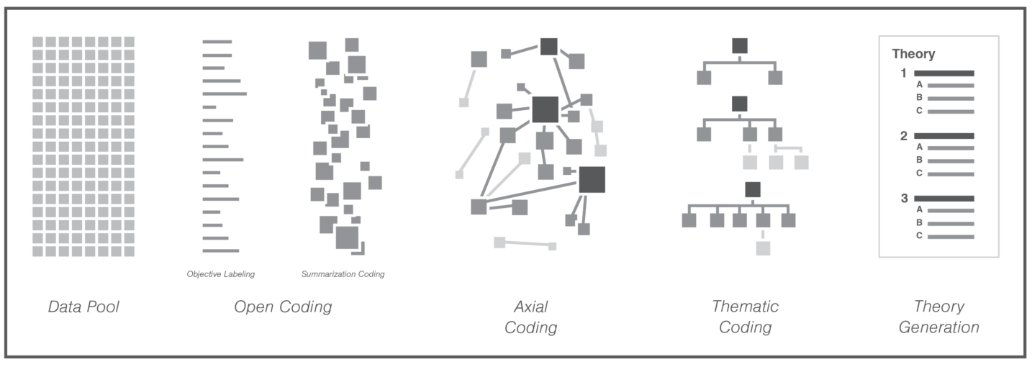
DATA CONDENSATION
Coding cycles
Transcriptions
First Cycle Coding
Second Cycle Coding
(Compton and Barrett, 2016)

Slide 13
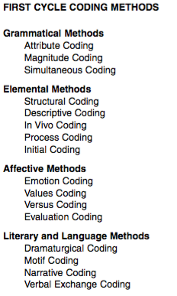
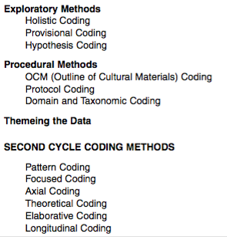
DATA CONDENSATION
Coding Methods
For definitions and descriptions: See Saldana, J. (2009). The coding manual for qualititave researchers.

Slide 14
DATA DISPLAY
Types of Data Displays
Miles, Huberman and Saldana (2014) recommends matrices and networks as the two fundamental methods for displaying data.
  Matrices, with defined rows and columns
  Networks, a series of nodes with links (lines and arrows) between them

Slide 15
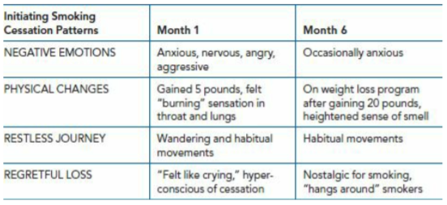
DATA DISPLAY
Types of Data Displays – Matrix Displays
Matrix display example from Miles, Huberman and Saldana, 2014)

Slide 16
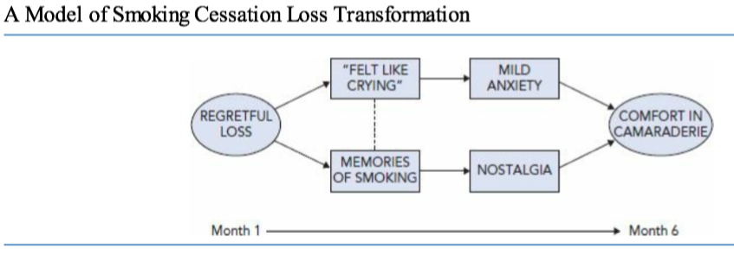
DATA DISPLAY
Types of Data Displays – Network Displays
Network display example from Miles, Huberman and Saldana, 2014)

Slide 17
DATA DISPLAY
Types of Data Displays – Other Types
Following can also be considered for displaying/representing findings:
  Comparison table: A table used to compare groups on one theme
  Hierarchical tree: A diagram that visually represents themes and their interconnections
  Figures/diagrams: A visual depiction that shows the connections between themes
  Drawings: Maps of the physical layout of the site
  Demographic table: A table of demographics on individual participants or research site

Slide 18
DATA CONDENSATION
Coding Workshop
Identification of the preliminary clusters (codes for deductive coding) – 20 mins
  Which categories do you foresee for making sense of the data? Write them down on post-its. These will be your ‘start list’ of codes at a higher level.
  E.g.
    Values – Consequences – Attributes
    Behaviors
    Tasks
    Concerns
    Strategies
    Expectations
Notes:
– you are trying to understand an experience from product design perspective
You need to consider whether there is an existing model that can guide how you can interpret data
You collect data about current experiences and habits – which factors underlie those?
You collect data about problems and preferences of users – what kind of concerns did you gather?

Slide 19
DATA CONDENSATION
Coding Workshop
Reviewing the transcriptions – (coding both deductively and inductively) – 60 mins
  Specifying ‘data chunks’: Underline the texts that should be included in the analysis and number each underlined text
  First cycle coding: Assign codes for each numbered text. Write the codes and numbers to a post-it. This time be more specific when naming the codes.

Slide 20
DATA CONDENSATION
Coding Workshop
Organizing the outputs – 30 mins
  Second cycle coding: Arrange the codes and group them. Some of the will be grouped under the preliminary categories that you have identified in the first phase, while some of them will be form new categories.
  Plan how you can integrate these data into spreadsheets for the rest of the analysis.

